Slide 1
Flourishing through faith, hope and love
Year 6 – Meet the Teacher

Slide 2
Staff
Mrs Alana Rowlandson
Mr Max Johnson - PE

Slide 3
Times of Day
School opens at: 8:35am – Morning Activity
(2 hours 5 minutes per week extra learning)
Morning break-time: 10:30am - 10:45am
Lunch: 12:00pm – 1:00pm
End of day: 3:15pm

Slide 4
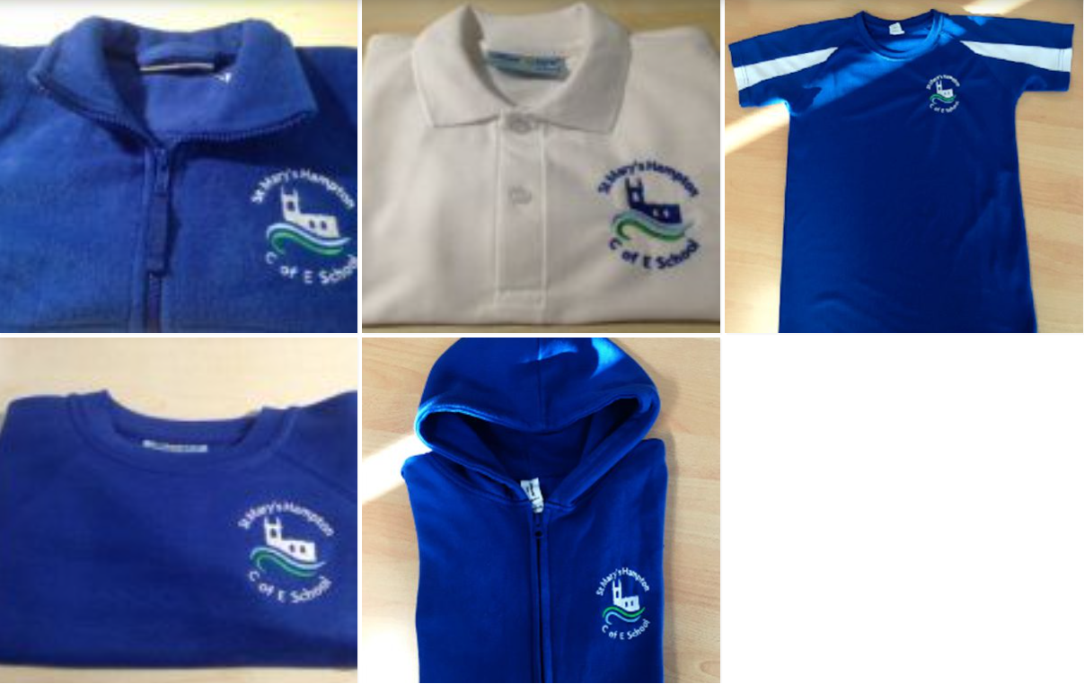
Uniform and Bags
The school colours are: royal blue & white
Royal blue sweatshirt (boys) or cardigan (girls) (with logo)
White polo shirt (the logo is optional)
Royal blue fleece (with logo) (not a compulsory item but may be worn as a jacket or as a outdoor top for PE)
Grey pinafore, skirt or tailored trousers
Royal Blue and white checked dress/playsuit (summer)
White or grey socks (not trainer socks)/grey tights
Flat heeled shoes (not trainers) in black or navy.
Hairbands, bobbles or small ribbons/bows – blue or white. Hair bows should be no more than 8cm in length.
Navy blue cap (with logo) which can be purchased via the school office only.
Bags:
Navy blue rucksack (with logo) – Years 3 and above

Slide 5
PE
PE Days
Mondays and Fridays
PE kit
Navy shorts, blue t-shirt (with logo), trainers (with velcro for children unable to do laces).
Navy jogging bottoms or navy leggings to be worn in winter for outdoor PE (branding to be minimal) along with a navy blue hoodie (with logo)
Navy blue PE bag (with logo)

Slide 6
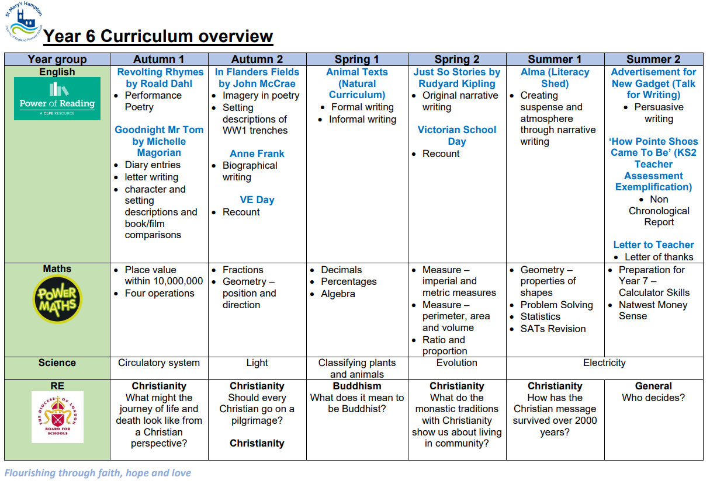
Curriculum

Slide 7
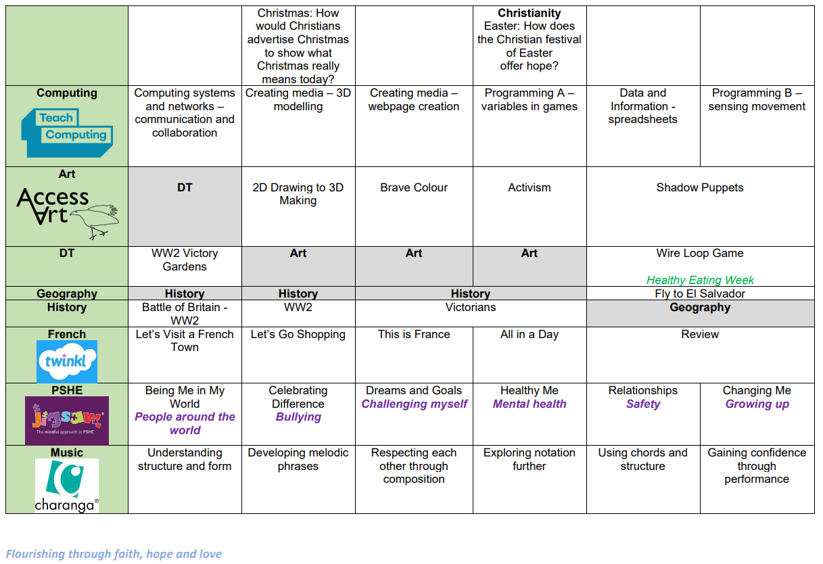

Slide 9
Pencil Cases
We encourage Year 5 and 6 pupils to have their own simple pencil case
Useful equipment: pencils, rubber, ruler, pencil sharpener, purple biro, a selection of highlighters, scissors, glue stick, protractor (semi-circular) and colouring pencils
We will provide your child with a handwriting pen and anything else they may need

Slide 10
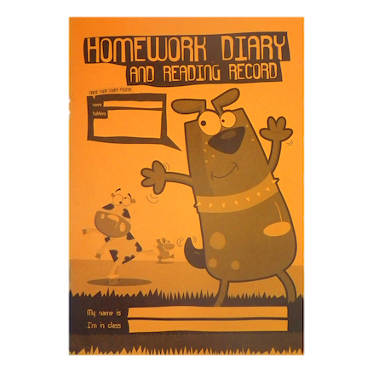
Homework
Each child will receive the following homework:
Reading (stage book) – 20mins per day (4/5 comments)
Spellings (usually Mondays)
Maths – Diagnostic Questions (weekly)
English – Blue folder (weekly)
Times Table Rockstars

Slide 11
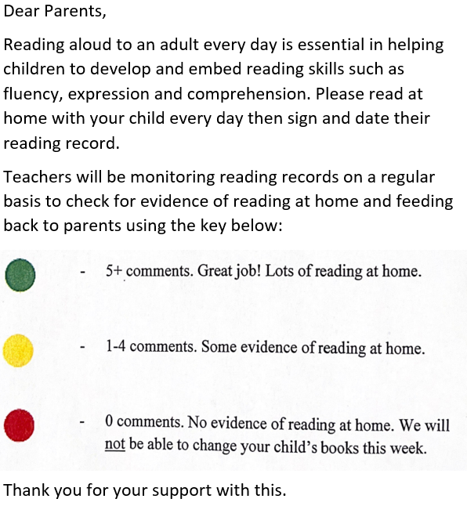
Reading
Additional Information:
Book Levels: chance to move up every half term
Your child’s day written in their homework diary
Children can write their own comments – Year 6 expectation
Please check homework has been completed and sign weekly – replicate secondary school

Slide 12
Reading

Slide 13
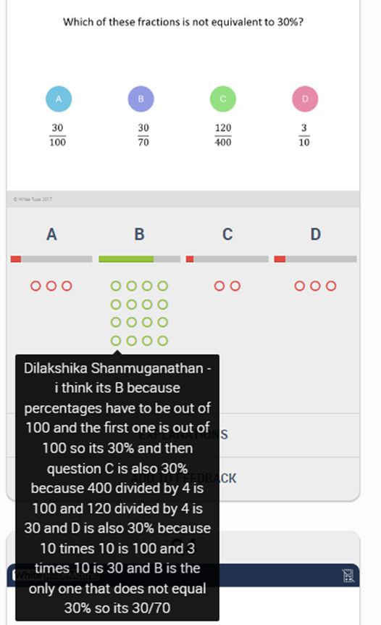
Maths Diagnostic Questions Homework

Slide 14
Spellings
Half termly spelling list – Year 6 statement to achieve the EXS standard in writing in Year 6. These tests normally take place on the last Wednesday of every half term
Weekly spelling lists. These tests will take place on Mondays (unless this says otherwise)
Spelling tests can be differentiated depending on which curriculum level your child is working on in English

Slide 15
Assessment
Spelling Tests
Weekly Spellings
Half termly spelling words
Power Maths
End of unit ‘mini quizzes’
SATs Practice Papers
Half termly
SATs Week
W/C 12th May 2025

Slide 16
Assessment – SATs
Provides a snapshot of your child’s attainment
The key stage 2 tests are timetabled from Monday 8th May to Thursday 11th May 2023
English Reading Paper
English Spelling, Punctuation & Grammar Paper
Maths Papers: Arithmetic and Reasoning 1 and 2
Children must attend school this week
English writing is teacher assessed
We do not expect children to revise
Your child’s wellbeing
Provides a snapshot of your child’s attainment
The key stage 2 tests are timetabled from Monday 12th May to Thursday 15th May 2025
English Reading Paper
English Spelling, Punctuation & Grammar Paper
Maths Papers: Arithmetic and Reasoning 1 and 2
Children must attend school this week
English writing is teacher assessed
We do not expect children to revise
Your child’s wellbeing

Slide 17
Assessment – Teacher Assessed Writing

Slide 18
Trips, Immersive Days and Tournaments
Autumn 1: Junior Citizen Trip (free) and PGL
Autumn 2: Swing Dance Workshop and VE Dress Up Day in the classroom (costume)
Spring 1: TBC
Spring 2: Victorian School Day (costume)
Summer 2: Bikeability and End of Year Production (costume)
Year 6 – Ensuring every child has a ‘Moment to Shine’
We aim to introduce a wide range of sports at a competitive level to a number of different children. We aim to build children’s characters by teaching them resilience in challenging sporting environments and good team building.

Slide 19
Secondary School Transition
Transition work in the summer term (additional group for vulnerable/SEND pupils) – most secondary schools provide additional transition days too
Some local schools visit pupils at their primary school
Will ask for teacher assessments (can be set based on these or their own tests at the beginning of Year 7). SATs results will not affect your child’s place at secondary school
Links with Bishop Wand
10 years experience in Year 6 in two different schools – do ask if you have any queries regarding transition

Slide 20
Thank you
Do you have any questions?

