Slide 1
Year 4 – Rome Information

Slide 2
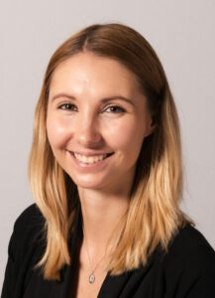
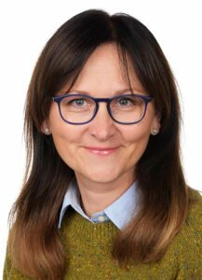
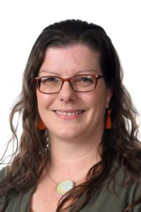
Teachers Teaching Assistants
Mrs Nesbit teaches on a Monday, Tuesday and Wednesday.
Miss Firmin teaches on a Thursday and Friday.
Mrs Popeda

Slide 3
Key Aims of Year 4
Promoting self-motivation and a positive attitude towards learning
Encouraging good manners and helpfulness
Developing organisational skills and presentation
Focus on core skills in English, Maths and Science
Developing speaking and listening skills
Encouraging independence and resourcefulness to prepare for upper Key Stage 2

Slide 4
Year 4 Curriculum
One main theme per half term
Cross-curricular approach linking English to our Foundation Subjects where appropriate
Continuing with Read, Write, Inc. spelling programme
Continuing with PenPals cursive handwriting programme – all children start on pencil before earning pen licenses
Maths scheme: Power Maths
Timestable Challenge
Multiplication tables check in Summer Term

Slide 5
Topics
Autumn 1 | Autumn 2 | Spring 1 | Spring 2 | Summer 1 | Summer 2
Drivers: History Romans Workshop: Roman London webinar | Drivers: Geography Rivers | Drivers: Science Chocolate! Visit: TBC: Chocolate workshop | Drivers: Geography Inspiring Iceland | Drivers: History Ancient Greece | Drivers: Science Robots Trip: TBC: Science Museum

Slide 6
Behaviour
Focus on being ready, respectful and responsible
House points for good behavior (team with most house points to receive reward each term)
Whole class rewards (50 rewards will earn a whole class treat each half term)
Golden Achiever certificate once a week
Zones of Regulation to help regulate emotions
Restorative approach to consequences which may include moving to a quiet area of the classroom, moving to a different classroom for a short period or completing a reflective conversation with a member of SLT

Slide 7
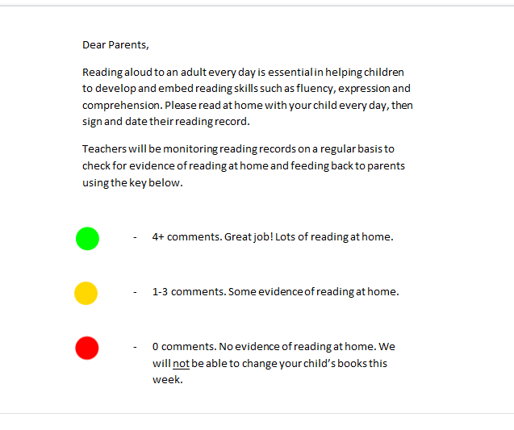
Reading
Please read at home at least 5 times a week and sign reading record. System in place to feedback on reading.
Children have a day that they need to change their books in the morning.
Reading stages assessed at the end of each term using the NFER scheme.

Slide 8
Homework
Weekly spelling tests based on rules learnt in class. Rule changes every fortnight.
Half termly common exception words to learn for St Mary’s Spelling Challenge!
Maths homework set on Diagnostic Questions every Monday.
Homework club every week.

Slide 9
General Reminders
PE days: Monday and Thursday
Please send children into school with fruit for their snack and a named water bottle
Look out for Year 4 notices within Friday newsletter
If you want to contact us, please email the ‘admin@stmaryshamptonschool.org.uk’ email address to set up a meeting, or catch us at the end of the day.

