Slide 1
Flourishing through faith, hope and love
Year 5 – Meet the Teacher

Slide 2
Staff
Class teacher: Mr Simon Burkey
Sports Coaches teaching PE: Miss Hannah Chandler

Slide 3
Times of day
School opens at: 8:35am
We have soft start: 8:35-9am – grammar/handwriting/maths activity and register.
Morning playtime: 10:30-10:45am
Lunch:12-1pm
End of Day: 3:15pm

Slide 4
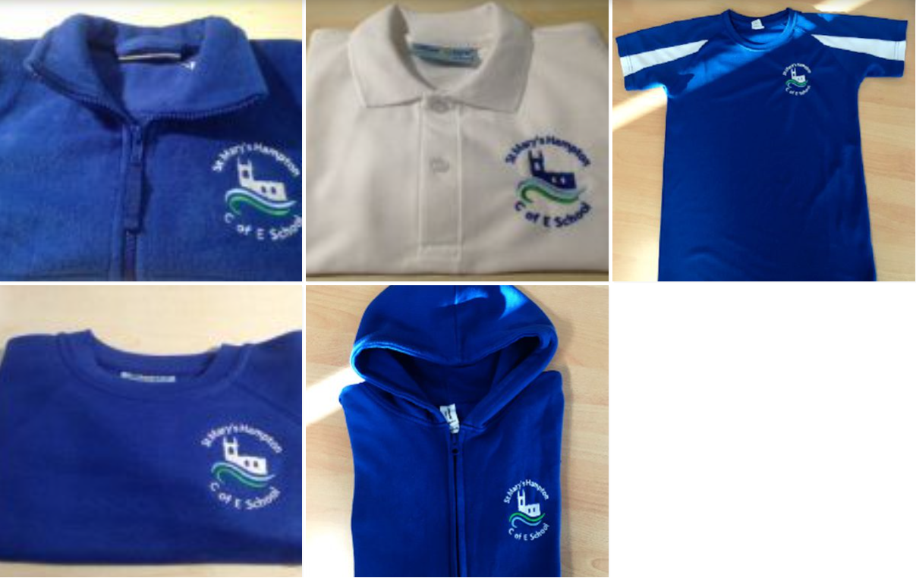
Uniform and bags
The school colours are: royal blue & white
Royal blue sweatshirt (boys) or cardigan (girls) (with logo)
White polo shirt (the logo is optional)
Royal blue fleece (with logo) (not a compulsory item but may be worn as a jacket or as a outdoor top for PE)
Grey pinafore, skirt or tailored trousers
Royal Blue and white checked dress/playsuit (summer)
White or grey socks (not trainer socks)/grey tights
Flat heeled shoes (not trainers) in black or navy.
Hairbands, bobbles or small ribbons/bows – blue or white. Hair bows should be no more than 8cm in length.
Navy blue cap (with logo) which can be purchased via the school office only.
Book bags (delete as appropriate)
Navy blue bookbag (with logo)- Reception to Year 2 inclusive
Navy blue rucksack (with logo) – Years 3 and above

Slide 5
PE and Swimming
PE Days
Monday (Swimming) and Friday
PE kit
Navy shorts, blue t-shirt (with logo), trainers (with velcro for children unable to do laces).
Navy jogging bottoms or navy leggings to be worn in winter for outdoor PE (branding to be minimal) along with a navy blue hoodie (with logo)
Navy blue PE bag (with logo)
Swimming
Swimming costume for girls (one piece), trunks for boys, swimming cap, goggles and towel.

Slide 6
Curriculum

Slide 7
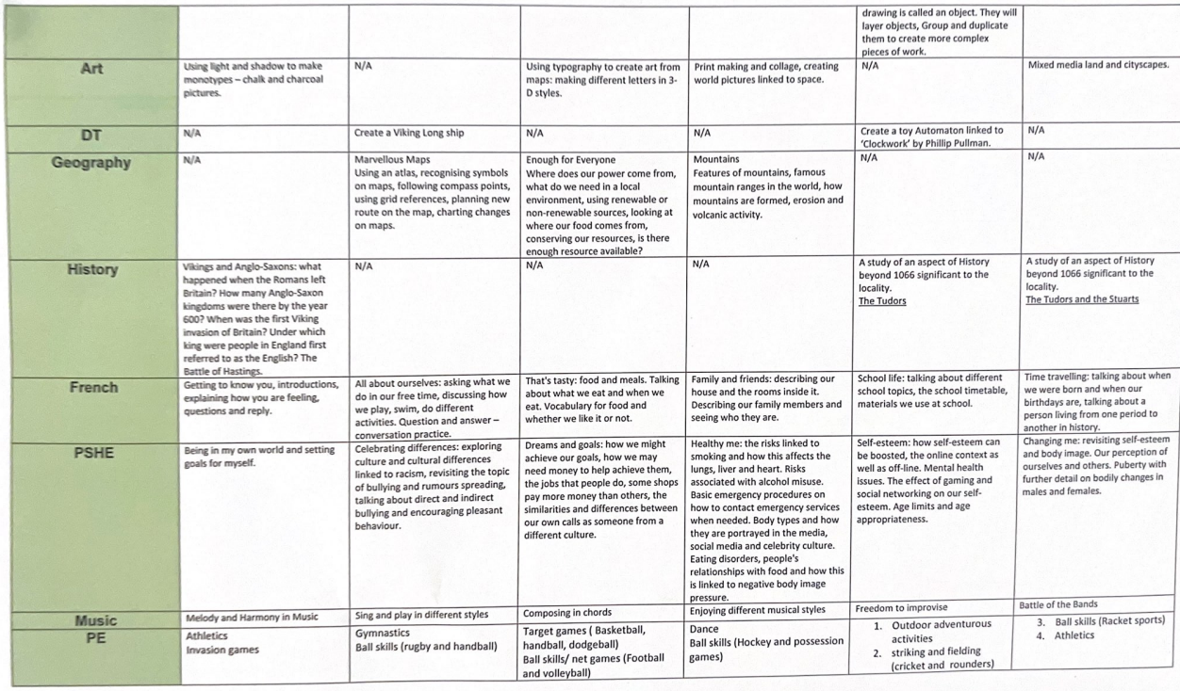

Slide 8
Homework
Each child will receive the following homework:
Reading (Stage book)
Diagnostic Maths.
English written homework.
Occasional maths written homework on alternate weeks.
Timestable Rockstars Practice.
Spellings to revise for the test.
Homework is set on Monday.
Homework is due on the following Monday.

Slide 9
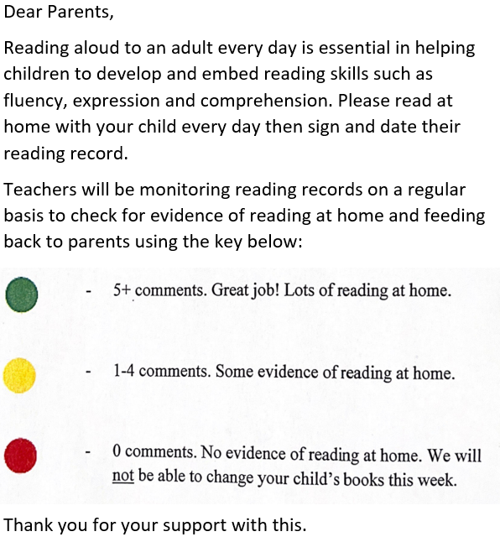
Reading
Children should read to adults at least twice a week. They can read to themselves at other times.
We need adult signatures to confirm that your child has read at least 5 times each week.
Less than 5 signatures means the child will read during break time.

Slide 10
Times tables
This is an online times table platform.
Logins and information
has already gone out
for families.

Slide 11
Maths Diagnostic Homework
Date set: each Monday.
Completion date: before the following Monday.
How to complete: use paper and pencil to help working out.
Input answers and explain method if appropriate.

Slide 12
Written Homework
Written homework is given out once a fortnight in year 5.
Children are asked to complete this and hand back it in before the following Monday.
Occasional maths written homework may also come out on alternate weeks to the English homework.

Slide 13
Spellings
Half termly spelling list which are comprised of the Common Exception Words for that year group. These tests normally take place on the last Wednesday of every half term.
Weekly spelling list. These tests will take place on Mondays. The pass mark will be 7/10.
Spelling tests are differentiated depending on which curriculum level you child is work on in English.

Slide 14
Assessment
Spelling Tests
Weekly Spellings
Half termly spelling
Power Maths
End of unit tests
End of half term tests
NFER Reading
Termly tests (Y2-6)

Slide 15
Trips, Volunteers and Tournaments
We will be taking a residential trip to High Ashurst in early February – more information to follow.
We will have another trip towards the end of the year centred on the Tudors and Shakespeare.
We may possibly take a trip to Winchester Science Museum too, depending on funds.
We aim to introduce a wide range of sports at a competitive level to a number of different children. We aim to build children’s characters by teaching them resilience in challenging sporting environments and good team building.

